Slide 1
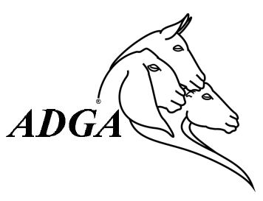
Test Day Basics
American Dairy Goat Association
  Tips for DHIR testing
  For further information, visit adga.org
  FAQs:
    http://adga.org/knowledgebase/dhir-faqs/
Notes:
Here is the basic sequence of events surrounding test day with regard to what is measured and where it goes off to.

Slide 2
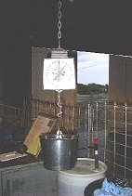
Test Day - Sequence of Events
Weights & samples taken at farm
Samples & barnsheets/data upload to the lab
Lab tests for fat, protein, & SCC
Lab results & data to DRPC
DRPC enters data
DRPC sends data to:
member/CDCB
Herd owner uses the data
Notes:
Here is the basic sequence of events surrounding test day with regard to what is measured and where it goes off to.

Slide 3
Professional Attitude
Testers & Owner Samplers are representing DHI!
On-Time (testers)
  30 minutes early for paperwork
Ready to Test
  Have your “Stuff”
Clean Clothes - Bio-security
Rubber Boots - Sanitized
Confidentiality
Notes:
So the focus is now on you, the tester. You may be friends, you may be barely acquaintances, it doesn’t matter – you are representing DHI and working for that organization. You will have a tester agreement on file with your association to that effect. Be there early enough to get any paperwork done before milking. Have your equipment with you. Consider biosecurity issues not only for the herd you test, but remember many of you will go home to your own herds. Respect what you learn about the herd that you now have a management partnership with. Revelations about the farm, the owners, the animals are not yours to divulge.

Slide 4
Box of Stuff
Extra pencils & pens
Sanitizer
Watch
Flashlight
Footwear
Paintstick
Scale? Dipper? Buckets?
Sample bottles, Shipper
Notes:
What should you have with you? If the herdowner does not have the above, then you need to provide it.

Slide 5
Data Collected
Identification
  Parentage and Offspring
Production Data
  Drying
  Culls/Sold Animals
Reproduction Management
  Kidding
  Breeding
Health Records
Notes:
Before you start, this is the information you will want from the herd owner. They may have done it themselves, or you may need to add it. If they have done it themselves, it is a good idea to check it over.

Slide 6
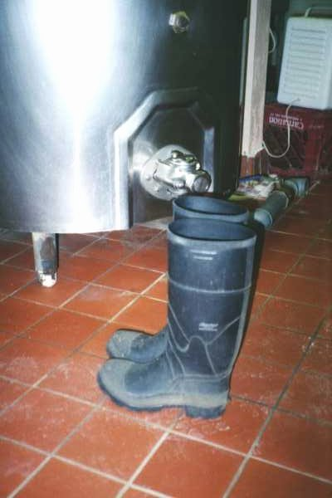
Preparation
Have clean equipment
  Scales
  Dipper
  Sample Vials
Biosecurity
  Boots
  Clothing
  Equipment
Notes:
Before you enter the milk parlor – these items need to be addressed.

Slide 7
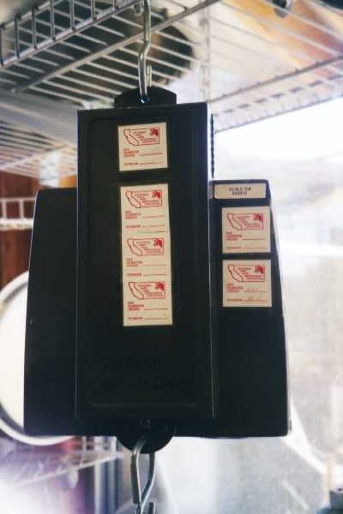
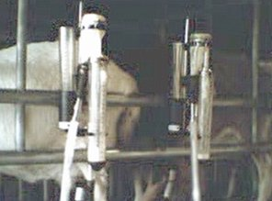
Scales & Meters
Tester’s scale/meter or Owner’s scale/meter must have certification within the last year.
Notes:
Scales should also be identified.

Slide 8
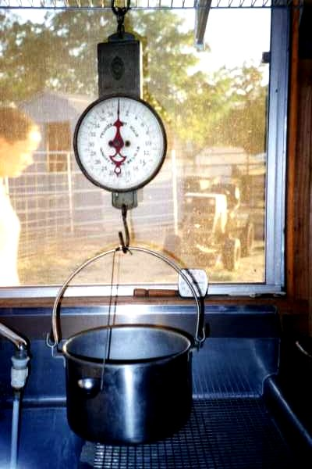
Tare the Scale
Zero the scale to the pail used for weighing prior to starting.
Note clock in background!
Notes:
If two needles, the tension needle should read zero with nothing on the hook. The loose needle is set to the weigh bucket. Keep scales away from damp conditions! Store in a safe place between tests – cover if necessary.

Slide 9
Milking Time
Ensure that the 24 hour period is correct
Organized in the parlor – sheets, sample vials, racks, computer
Test day procedures are important
  Should represent normal milking days as closely as possible
Working conditions conducive to accurate representation of the herd
Notes:
Help are the major items the tester and producer should consider to ensure that monthly samples represent the average daily production of milk and butterfat for the test period and a cow's normal milk yield fora 24-hour period on test day.1. Milk at the regular time. (To make 24 hours in the test period, the AM milking should begin at the same hour when the AM milking began the day before.)3. Milk rapidly and do not overstrip on test day.4. Do not handstrip unless also done on other days.5. Milk cows in the same order as on other days.

Slide 10
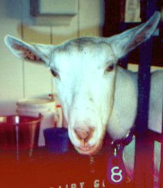
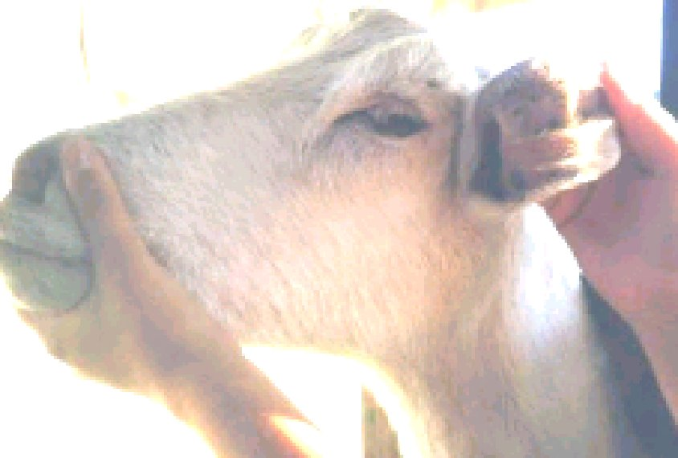
Getting Started - Visible & Permanent ID
Check tags each test day
  Tag = control # or ID/Name
Check tattoos on any herd additions,
  Occasionally “spot check”
  EVERY VERIFICATION
Notes:
Tags don’t always stay on… Just have them on for test day – that is the visible ID. If you use the little snap hooks, it will work fine.

Slide 11
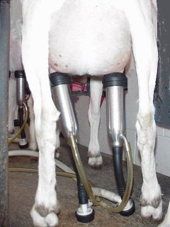
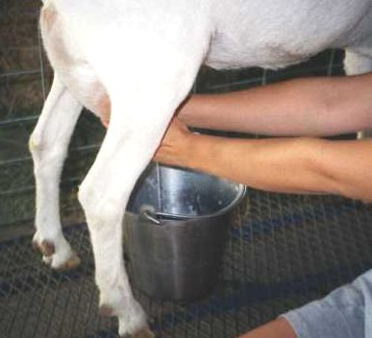
Observe Milking
Observe milking
  You are the Supervisor! (S. Hank)
Note Start time when milking
1st doe in herd
Note Stop time after
last doe in herd is
milked

Slide 12
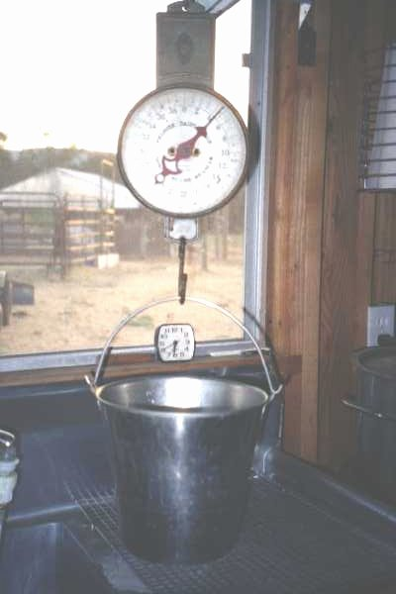
Weigh Milk
Weigh milk and record to 10th of a pound. Convert if using a lb/oz scale.
Record on cow barnsheet or enter into program
Notes:
Weigh first and write it down. Get a routine which will help you to not forget weights or samples.

Slide 13
Sampling
Obtain a representative Sample!
What affects test sample:
  Milking Interval (AM – PM,
  Influence of stage of milking on composition
  Influence of stage of lactation
  Feed
  Sample Handling
    Preservatives
    Avoid temperature extremes
    Ship quickly
Notes:
Sampling is critical whether from a pail or meter. It must be taken from the entire amount of milk produced. Strippings from animals that are machine milked should be added into the bucket prior to sampling. If you forget a sample – do not go back and get just enough from the doe. Better to have it estimated as a lost sample. A common question is, “I feed sunflower seeds to improve butterfat” – is that OK? It is if it is part of the routine management. “I feed a chocolate bar on test day” is not acceptable as it is influencing test day (or so they think).
Test Day technique can affect the sample in many ways as stated in the last section of this slide.

Slide 14
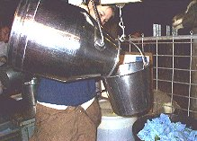
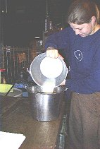
Sampling Technique
  Pour three times back and forth or stir, stir, stir
    because
  We want a representative sample and goat milk has smaller fat molecules, but it is not naturally homogenized.
Notes:
So – with that in mind, we want you to follow this guidelines.

Slide 15
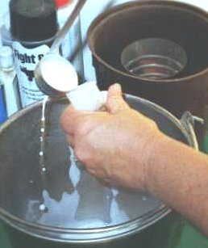
Taking the Sample
Sample must be from all milk obtained from the doe
For Standard test, a half sample is taken at each test
For alternate component test plans, a full sample is taken
If properly mixed, it doesn’t matter if sample is from top, bottom or middle
Notes:
After mixing, take the appropriate sample depending on the test type plan.

Slide 16
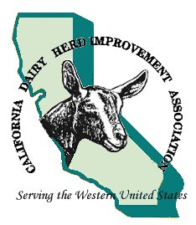
Filling
Proper Sampling Technique
  Fill sample to slightly less than 1/2 full on 1st milking
  Same vial to 80% full on 2nd milking

Slide 17
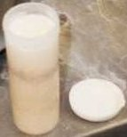
Vials
Check to make sure preservative is present
Label lid with Sample # or Control # or however your DHIA prefers
Leave ¼ inch space at top
Gently mix sampled milk with preservative
OLD STYLE Cap picture –
NEW have attached SNAP CAPS
Notes:
Don’t shake! But mix the preservative into the milk.

Slide 18
Entering Information
Garbage in = garbage out
Pre-test
  Status changes – kidded, dried off, sold, aborted
  Reproductive changes – heats, breeding
  Herd health
  Identification
  Corrections
Notes:
As with anything, accuracy is important – There are consequences to missing, poor, or incorrect information. Before (or after) milking, these items need to be checked and updated.

Slide 19
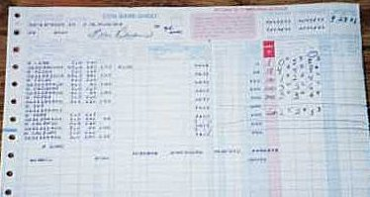
Checklist
Weights
Sample #
Dated
Signed
Herd Info
Stop/start times
Sampled check
VT check

Slide 20
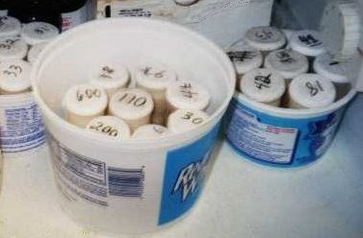
Sample Storage
Room temperature if not too hot
Store upright
Keep out of sunlight
Refrigerate if over 75°
Secure storage is tester’s responsibility
Notes:
Storage guidelines. It is best to ship as quickly as possible. Samples should remain in the tester’s possession.

Slide 21
Test-Day Checklist
Weights and samples on every milking doe
Dry, sold, or died on remainder
Enrollment data on new animals
Samples mixed & packed
  Protect from sunlight
  Rock & Roll to disperse preservative
  Chill when herd finished (DO NOT FREEZE)
  Properly marked sample vials
Paperwork included w/notes or corrections

Slide 22
Completing the Test
Check for correct status codes/CAR codes
Samples properly marked?
Barnsheets dated, signed, marked for “V” if applicable?
Date of test is last weighing/sampling date
Pack and ship

Slide 23
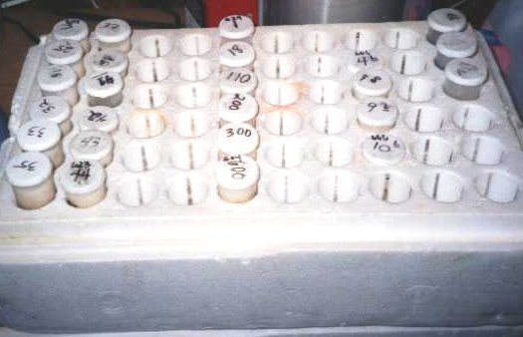
Shipping
Separate groups
Herdcode at 1st and last sample if more than one herd
Shipping boxes available or make own – egg cartons (prevent potential leaking)
Secure lids
Cool pack if hot weather
Insert sheets outside of samples & in plastic bag.
Notes:
Keep in mind arrival times to the lab. Most aren’t open on weekends! Optimally, samples should arrive within 6 days of the test.
If you make your own shipper – keep in mind such things as preventing leaks. You might want to put a single strip of tape over the lid (especially if the old style). Check with your lab for their preference.

Slide 24
Verification Testing
Perform on animal or herd basis, dependent on Test Plan or goal
Required for:
  Top Ten Recognition (individual)
  Innovative Test Plans (herd)
  Owner Sampler (herd)
Responsibility of herd owner
Do it Early
Notes:
Verification is a unique test done for a variety of reasons. An owner can choose to have one, or it may be required as part of their test plan option. It is important to know whether it is required on an animal basis or a herd basis. Some associations require all VT’s to be on a herd basis. It is important to know your local rules.
Don’t wait! Remember what you might be validating. You might be validating the next breed leader and as that breeder, you want the verification to show exactly what doe was doing at her peak – not when she was just about ready to be dried off.

Slide 25
Verification Testing
Requires VT form, even if at a 1-day
If two testers, both testers complete portions of the VT form
Both testers sign if two
DHIA Manager must sign
Tips
  Use copy of herd summary from previous test
  Large herds – ‘Empty ✓’ for pre-milk
Notes:
A VT can be at a 1-day but all paperwork needs to be done – the 1-day, the VT form and the barnsheets! It gets complicated!
VT forms will be returned for lack of DHIA manager signature.

